Slide 1
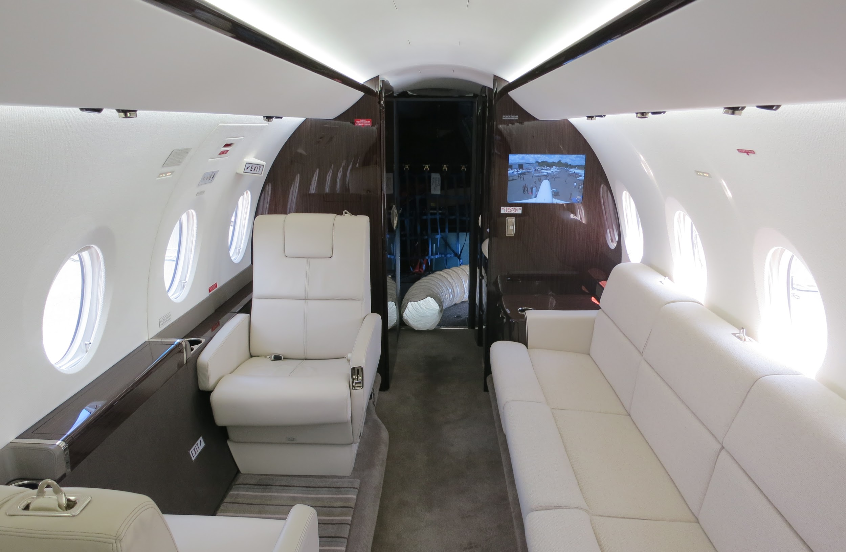
Designing, building and maintaining aircraft
Write your names here.

Slide 2
State the ranking of the Canadian Aerospace Industry in turbo prop and helicopter engine production in 2015.

Slide 3
Where can qualified aircraft maintenance technicians find employment in Canada?

Slide 4
Aviation technical personnel are expected to be knowledgeable in what four areas?

