Slide 1
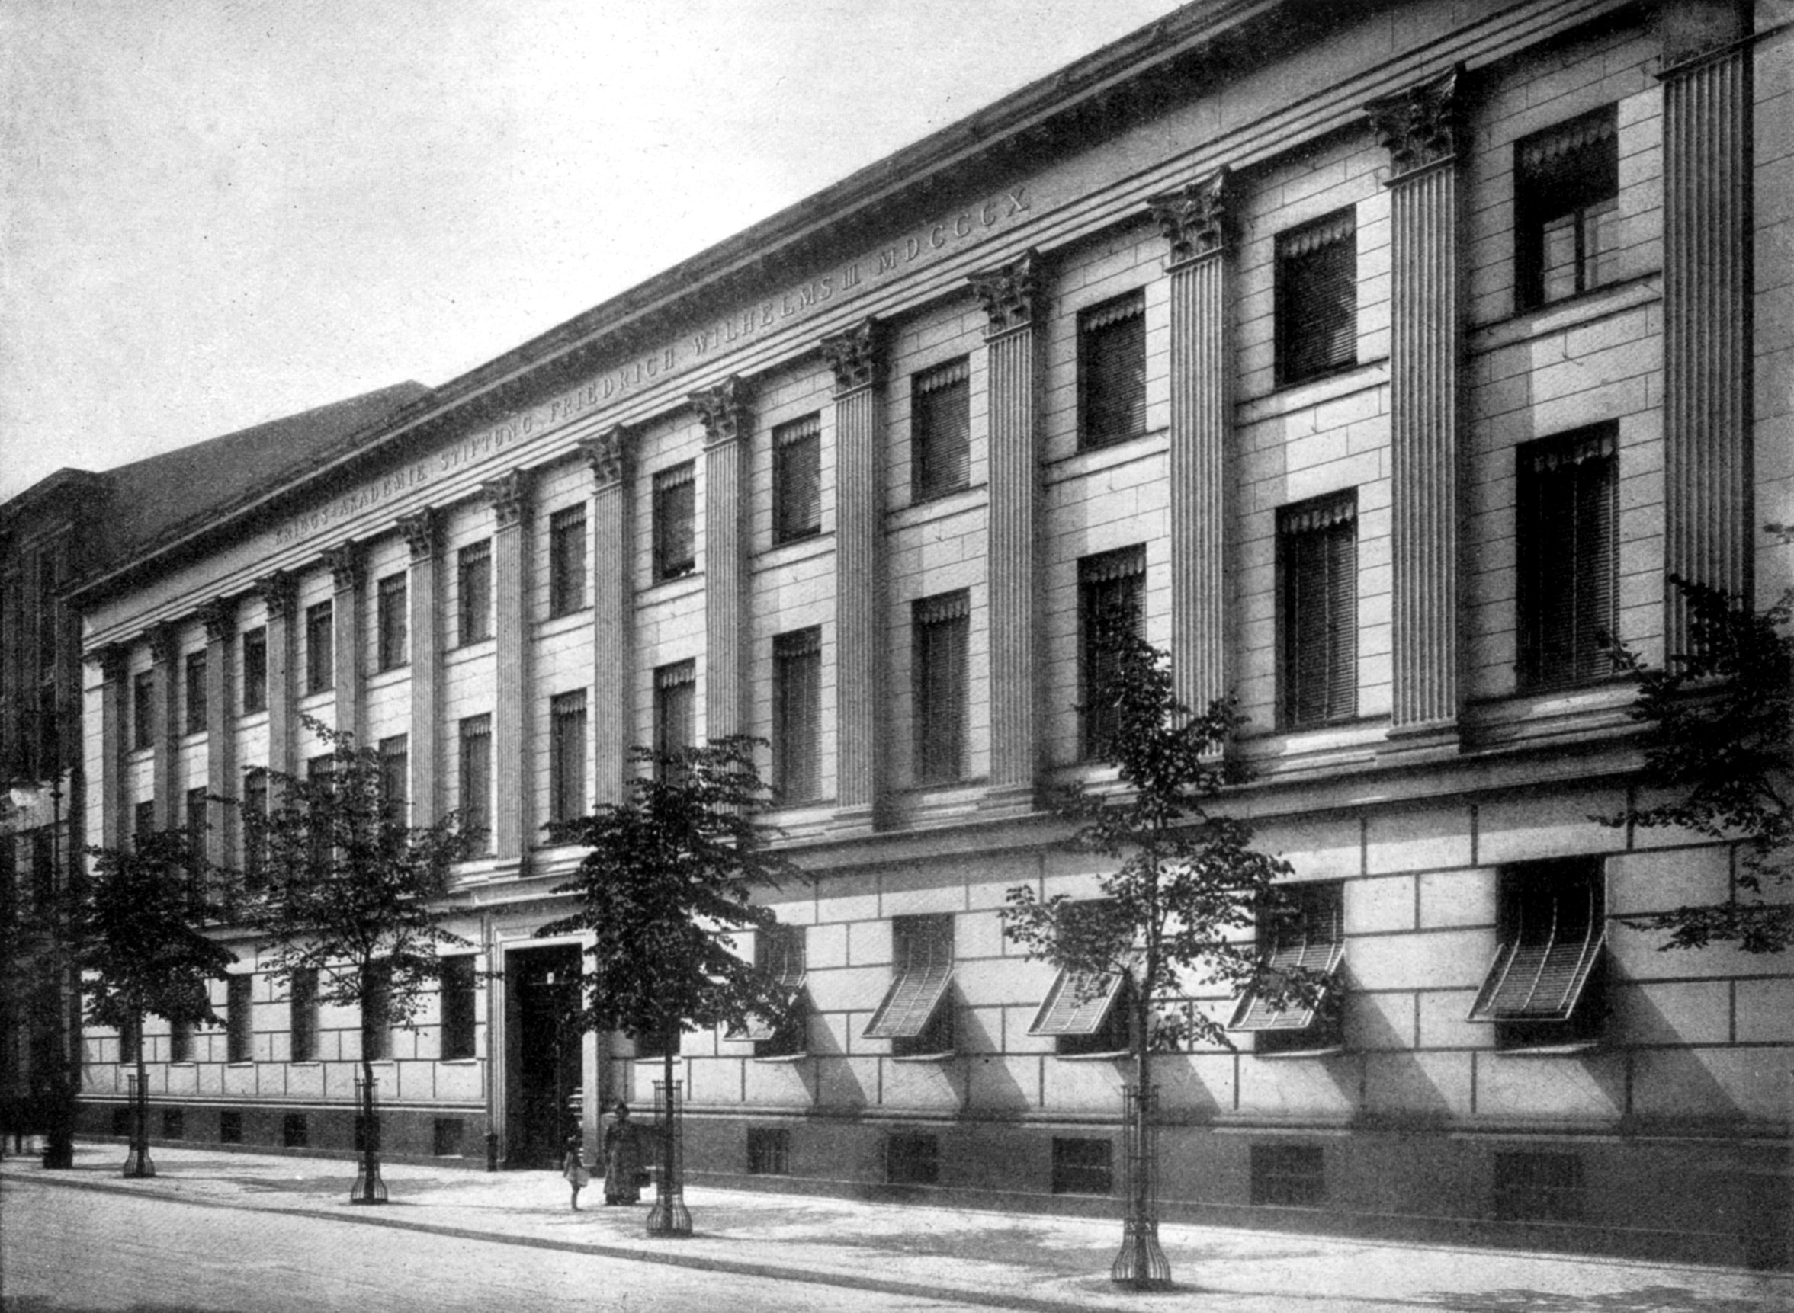
Flight Colleges
Write your names here.

Slide 2
What types of training are provided by Flight Colleges?

Slide 3
What types of equipment are utilized by the Flight Colleges to facilitate the training?

Slide 4
What provinces of Canada host Flight Colleges?

