Slide 1
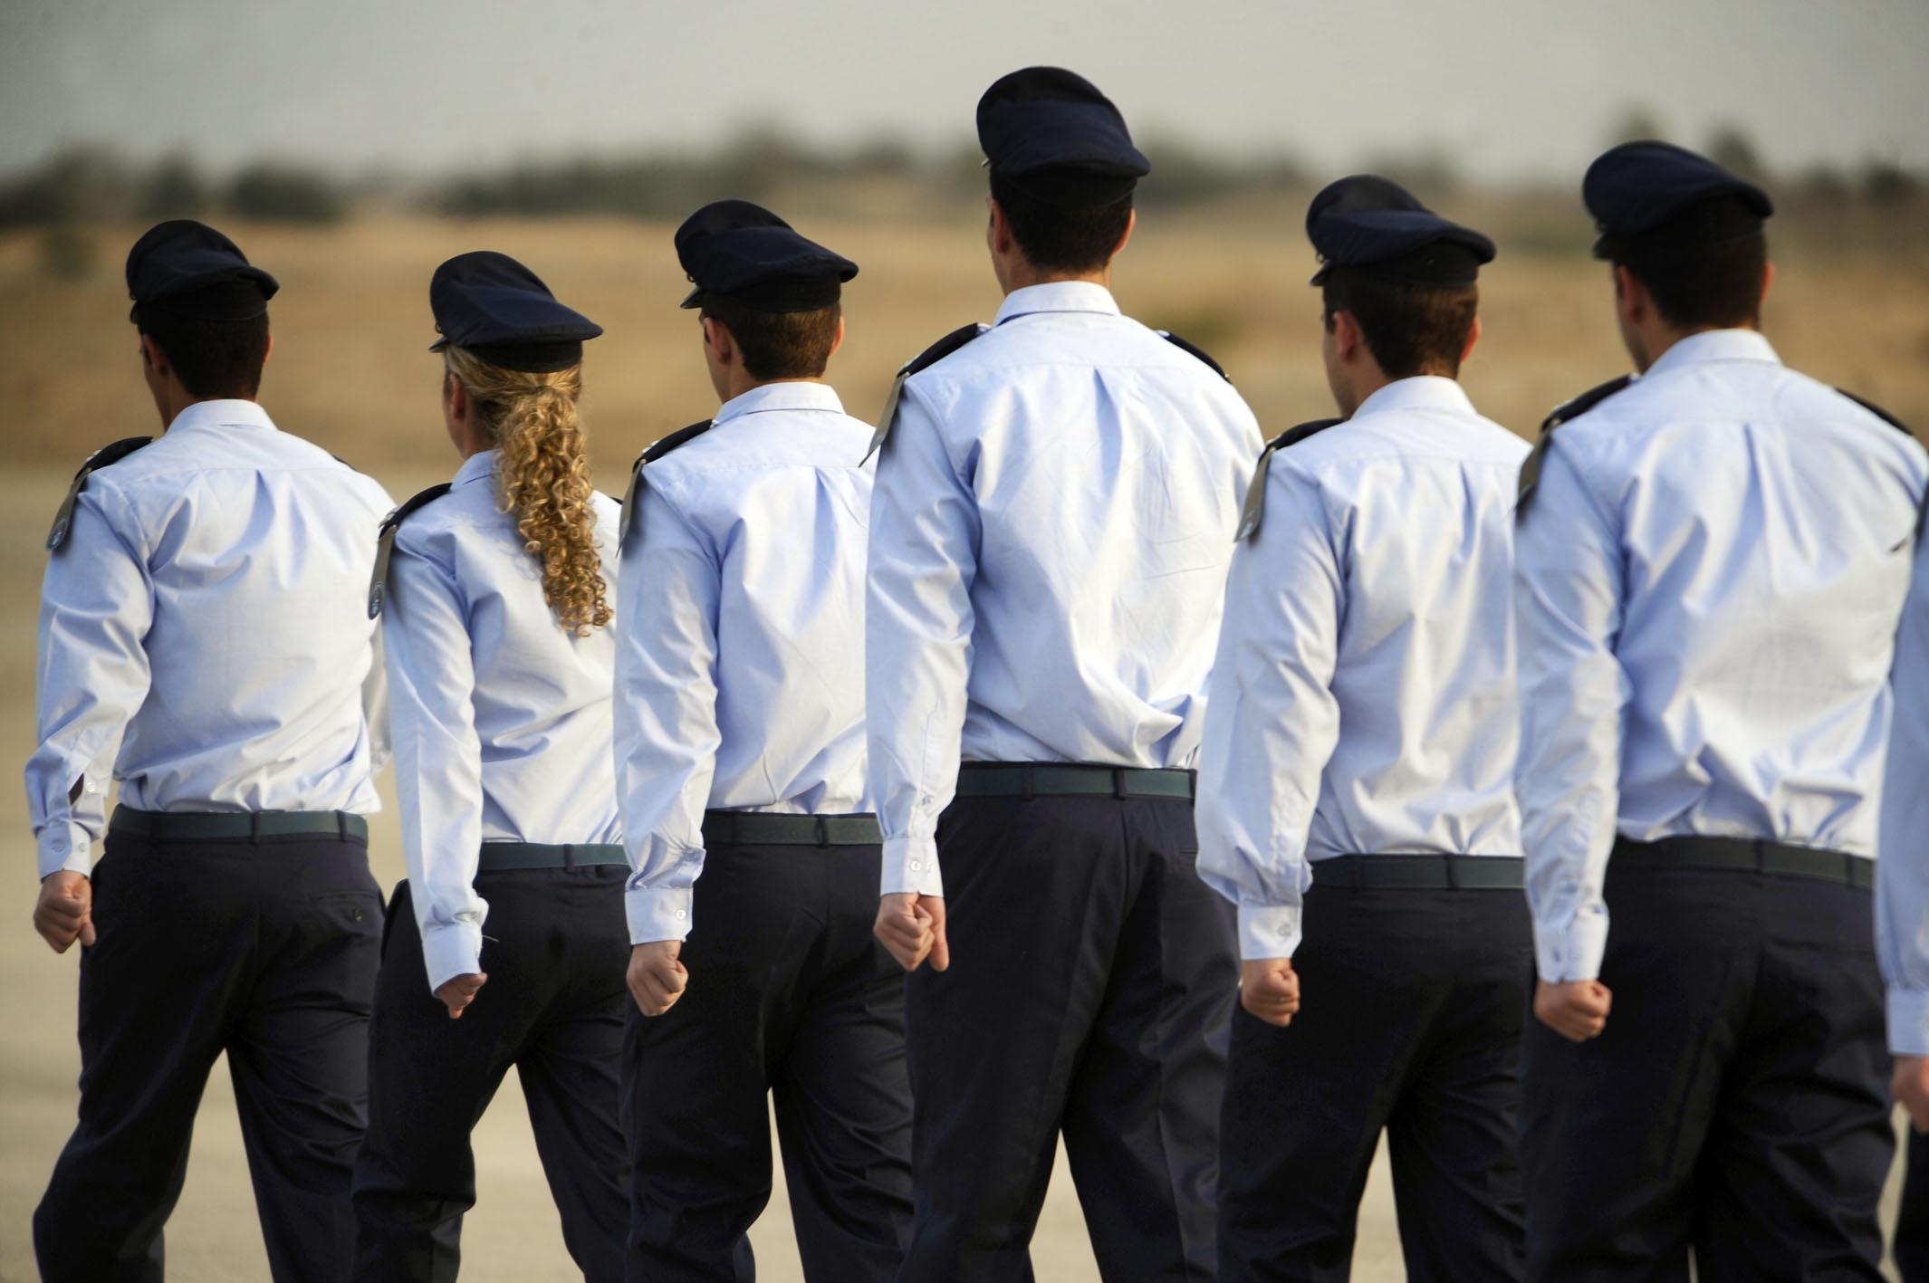
Flight Schools
Write your names here.

Slide 2
How many flight schools specialize in fixed wing training?

Slide 3
Which flight schools train pilots specifically in rotor aircraft?

Slide 4
What type of training do they provide?

