Slide 1
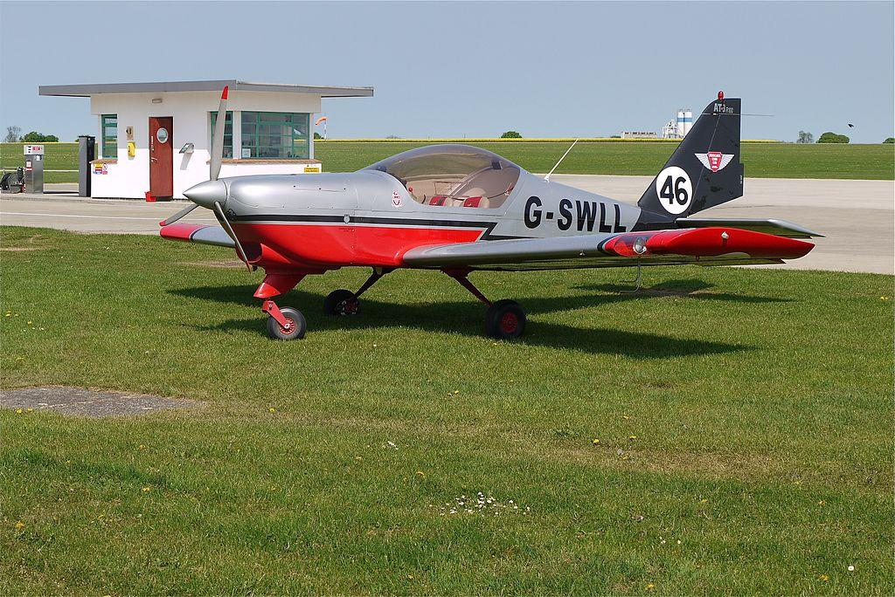
Flying the Aircraft
Write your names here.

Slide 2
How many new pilots and technicians will be required over the next 20 years?

Slide 3
What is the average number of hours required for a Airline Transport Rating?

Slide 4
Is flight training expensive?

