Slide 1
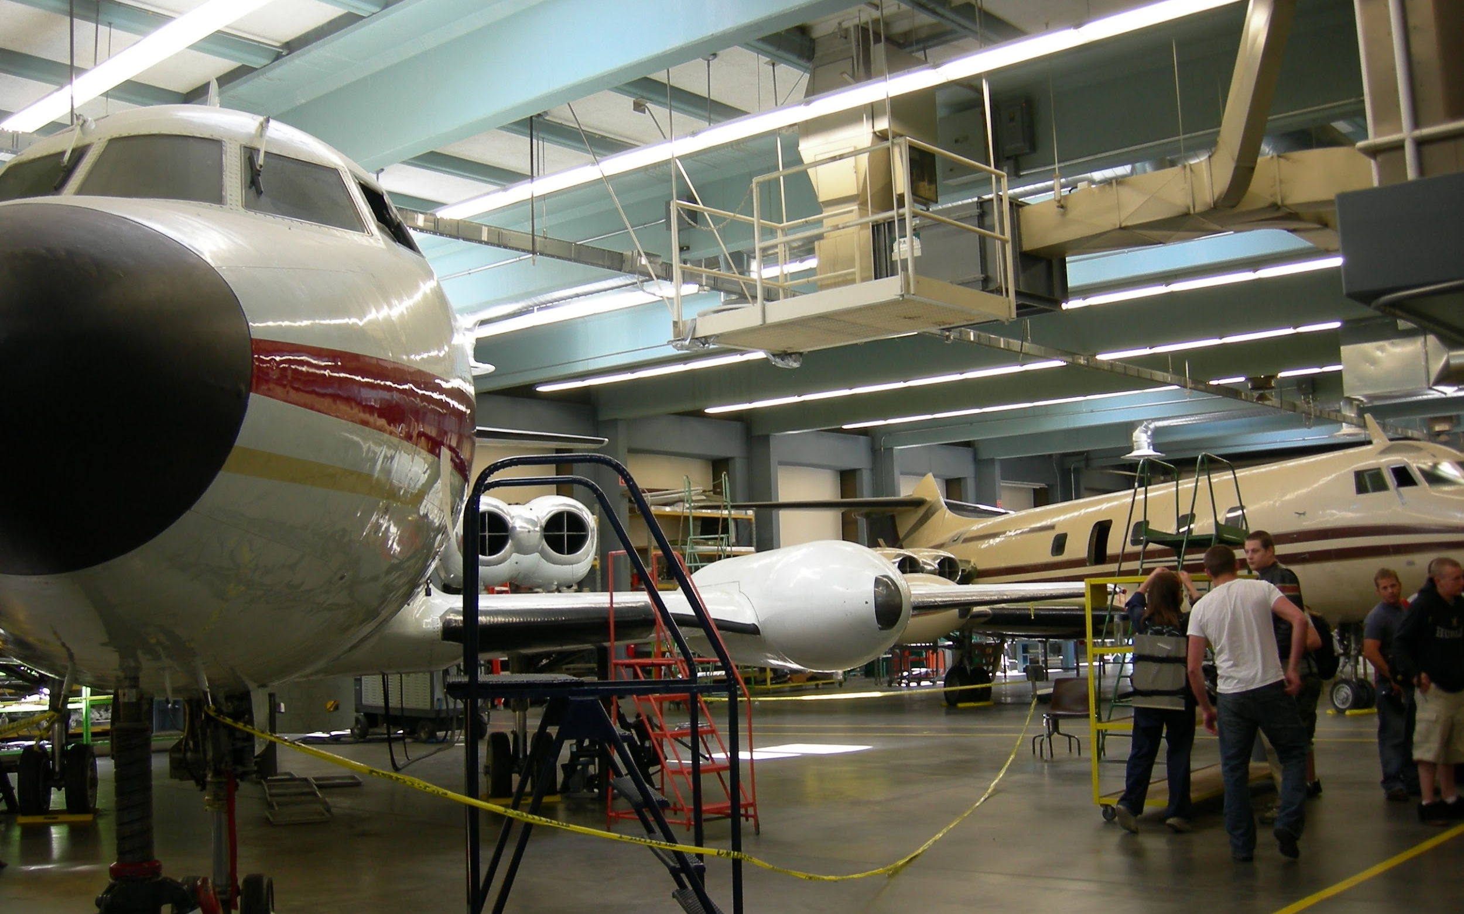
Maintenance Colleges
Write your names here.

Slide 2
What is aerospace manufacturing demanding from the training establishments?

Slide 3
How many months training is required to obtain an Aircraft Maintenance Technician licence in Canada?

Slide 4
What fields of learning would you expect from Maintenance Colleges?

