Slide 1
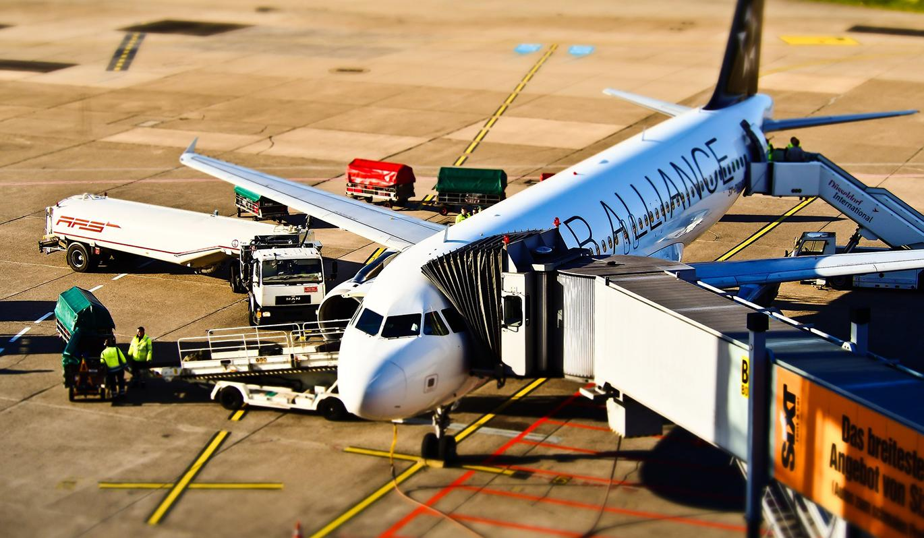
Supporting the Aircraft
Write your names here.

Slide 2
If you are not looking to become a pilot or aircraft maintenance technician what other discipline can you consider?

Slide 3
What career discipline is responsible for the loading and unloading of aircraft?

Slide 4
A Flight Dispatcher is like a?

Slide 5
Air Navigation employees provide what service?

