Slide 1
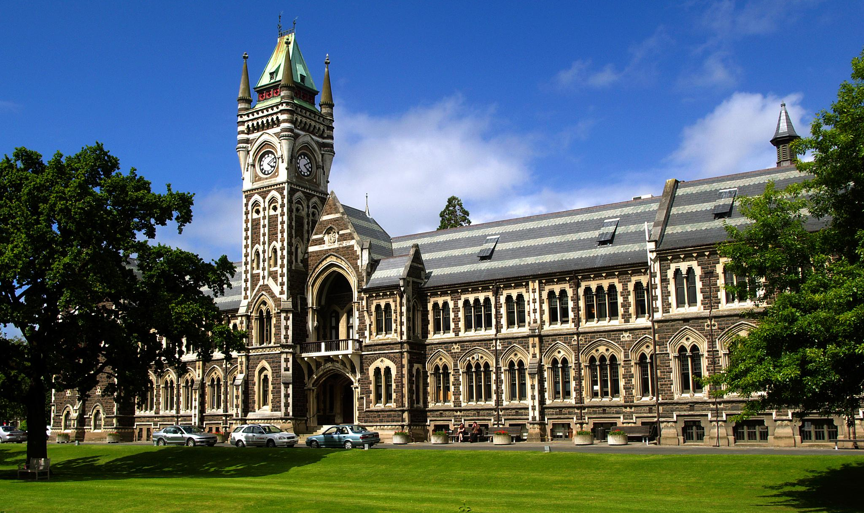
Universities with Aviation Disciplines
Write your names here.

Slide 2
How many aircraft have the World Airlines ordered for the next twenty years?

Slide 3
Why is Canadian Aviation looking at Universities with Aviation Disciplines?

Slide 4
Canadian Universities provide what levels of education in support of the Aerospace and Transport Sectors.

